Slide 1


Slide 2
Environment based testing
Notes:
HELLO EVERBODY.
TODAY WE ARE GOING TO HAVE A LOOK AT RUNNING TEST IN DIFFERENT ENVIRONMENT OR EXCLUDE THEM IF NEEDED BASED ON ENVORINMENT.

Slide 3
Spring Boot and conditional testing
Excluding any test is possible
Unit tests are worked more frequently than integration test
Environment based testing is needed
«IfProfileValue» annotation for this purpose
Notes:
{click} GENERALLY, UNIT TESTS AND INTEGRATION TEST ARE BUILD UNDER THE SAME PACKAGES. SO WE CAN RUN ALL THE TESTS AT THE SAME TIME OR EXCLUDE THEM.
{click} BUT WHILE DEVELOPMENT TIMELINE. DEVELOPERS USUALLY WANT TO FOCUS ON THE UNIT TEST MORE THAN INTERGATION TESTS AND PREFER TO RUN INTEGRATION TEST LEST FREQUENTLY. BECAUSE RUNNING INTEGRATIONS TEST OFTEN WILL SLOW DOWN THE DEVELOPMENT AND TESTING LIFE CYCLE.
{click} SO, DEVELOPERS NEED TO RUN INTEGRATION TEST BASED ON A SPECIFIC ENVIRONMENT OR BASED ON SPECIFIED VALUE OF A VARIABLE AND IN OTHER CONDITIONS THESE TEST WILL BE DISCARTED AND WHOLE LIFE CYCLE WILL BE ACCELARETED.
{click} FOR THIS PURPOSE, SPRING BOOT PROVIDE US “IFPROFILEVALUE” ANNOTAION.

Slide 4
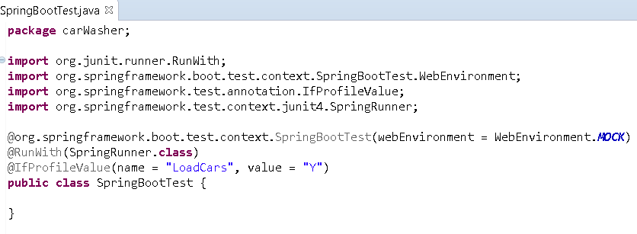
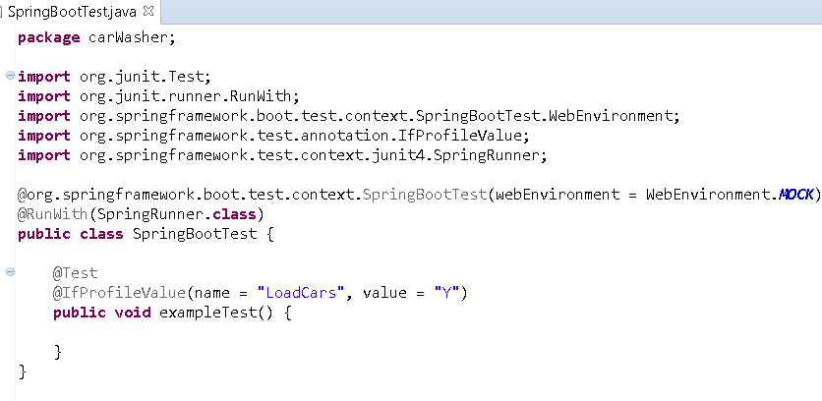
Spring Boot and conditional testing
Notes:
WITH THIS ANNOTATION “IFPROFILEVALUE”-ANNOTATED TEST WILL BE ENABLED OR DISABLED BASED ON AN ENVIRONMENT OR SYSTEM VARIABLE.
"IFPROFILEVALUE” IS NOT ONLY USED ON METHOD-LEVEL BUT ALSO CLASS-LEVEL.
OF IT IS USED ON TOP OF CLASS WHOLE CLASS METHODS WILL BE ENABLED OR DISABLED.
FOR EXAMPLE LETS ASSUME WE HAVE JVM PARAMATER WITH NAME “LOADCARS”. WE WILL SET THIS VALUE Y OR N VALUES
IF WE USE “IFPROFILEVALUE(“LOADCARS”,”Y”)” ON THE TOP OF A CLASS, SPRING BOOT SEARCHS FOR “LOADCARS” JVM OR SYSTEM VARIABLE AND IF “Y” VALUE IS FOUND ANYWHERE,
FOR XAMPLE IF WE HAVE PASSED “-DLOADCARS=Y” JVM PARAMETER, THIS CLASS’S TEST METHODS WILL BE RUN, OTHERWISE THIS CLASS WIIL BE IGNORED BY SPRING BOOT. AS WE TALKED BEFORE, THIS ANNITATION WILL BE RUN AT THE SAME WAY IF WE PREFER TO USE IT METHOD-LEVEL.

Slide 5

End of this course
Notes:
IN THIS COURSE, WE TALKED ABOUT RUNNING SPRING BOOT TEST BASED ON DIFFRENT ENVIRONMENT.
SEE YOU NEXT CLASS. HAVE A NICE DAY.

